Slide 1
My ignoring machine
Denoising AutoEncoders

Slide 2
Theoretical background
Predictable distractor
Unpredictable distractor
Amplitude (dSPM)
Time (sec)

Slide 3
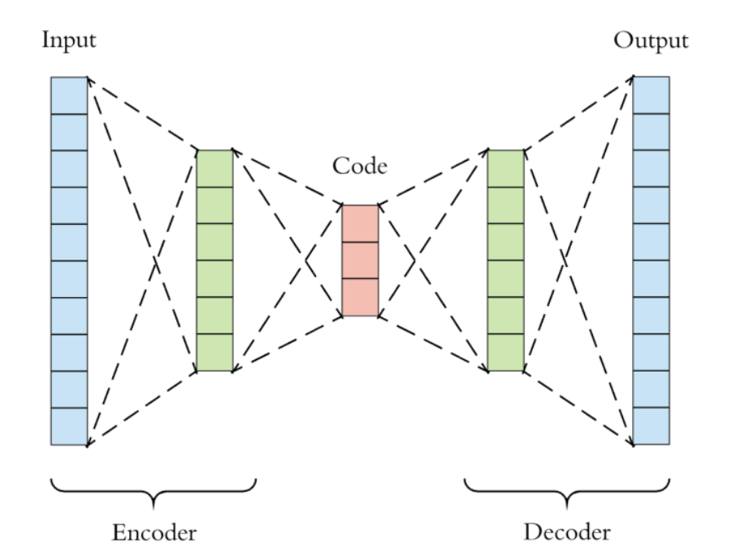
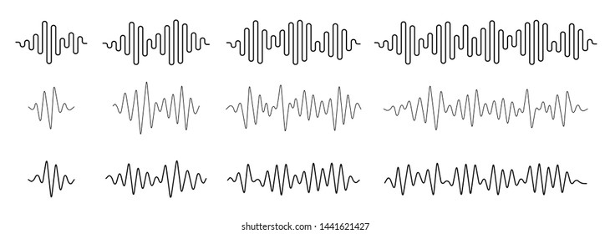
AutoEncoders, self-supervised machines
Task-relevant
Task-relevant
+
Irrelevant

Slide 4
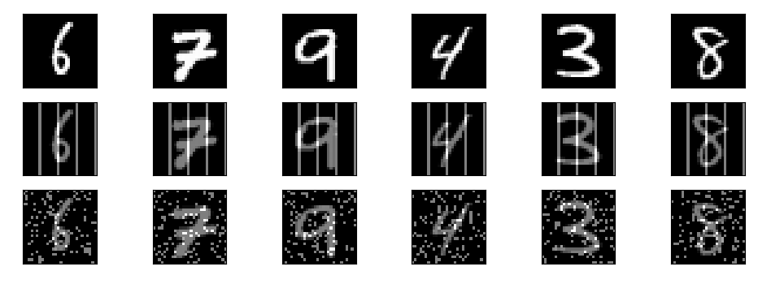
MNIST dataset (train: 60K, test: 10K samples)
sample1
sample2
sample 60K
Original
…
+ regular irrelevant information
+ random irrelevant information

Slide 5
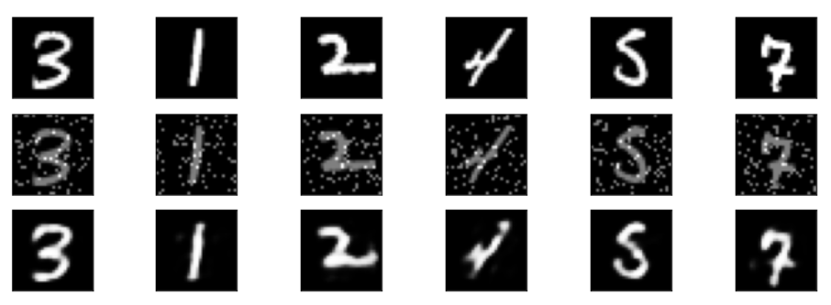
AutoEncoders, self-supervised machines

Slide 6
AutoEncoders, self-supervised machines
original
Train
Test
original

Slide 7
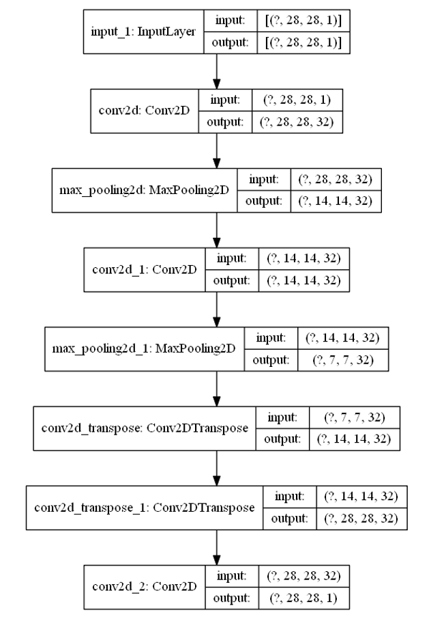
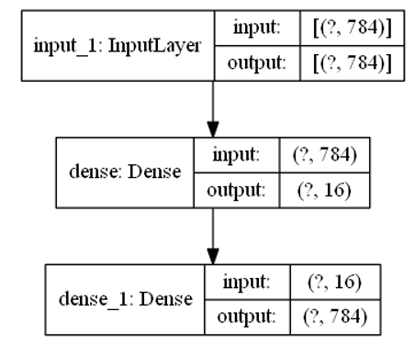
A bit more complex model
Simple model

Slide 8
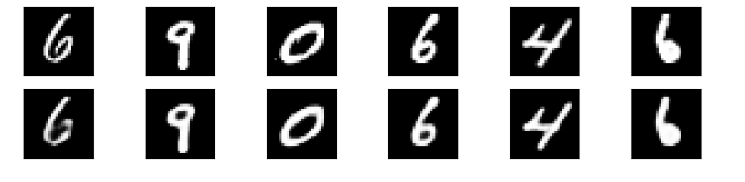
Sanity check – Autoencoder works

Slide 9
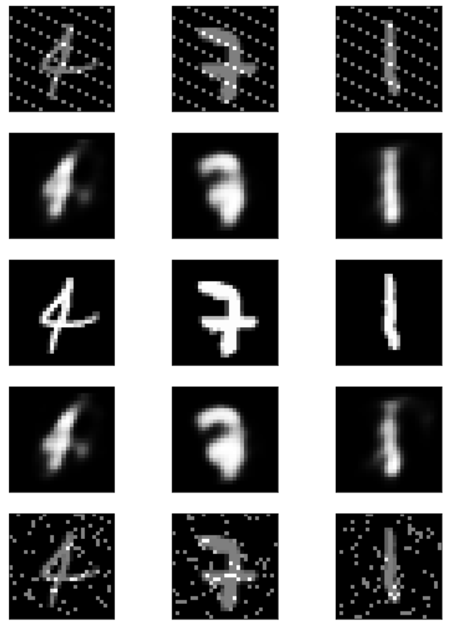
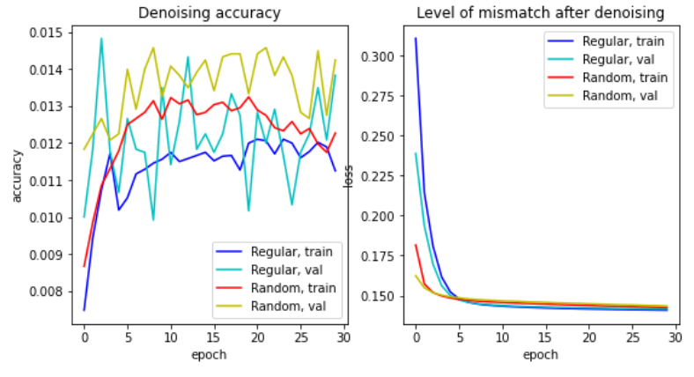
Simple Model results
Reconstruction regular ‘noise’
Original
Reconstruction
random noise

Slide 10
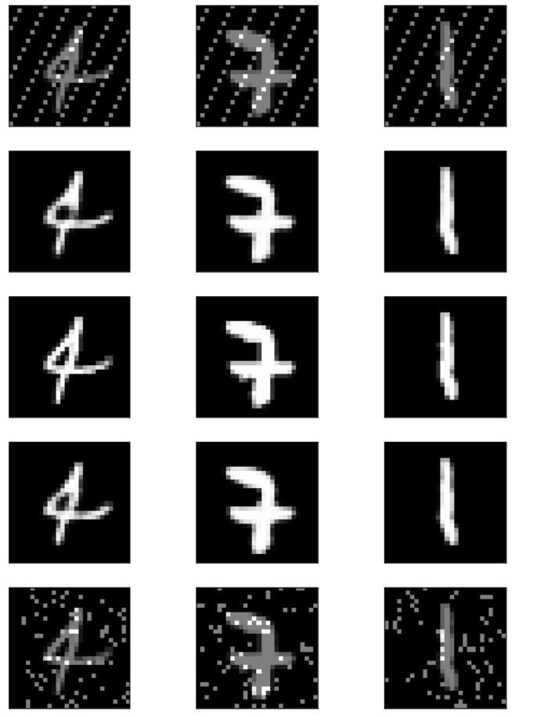
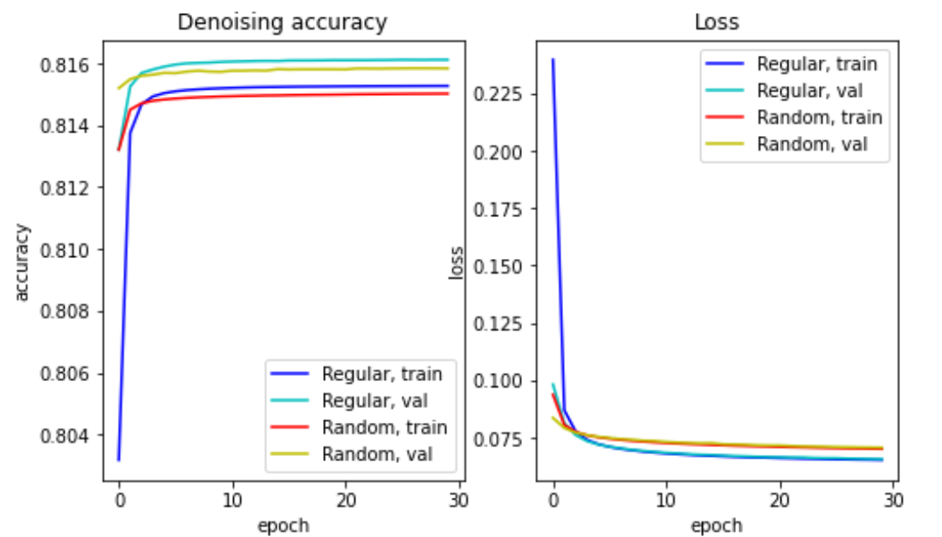
Conv. Model results
Reconstruction regular ‘noise’
Original
Reconstruction
random noise

Slide 11
Interim summary:
Conv. net is more robust than a simple dense-layers AE.
Regular (vs. random) irrelevant information:
Requires more epochs to learn
Reaches lower loss
Things left to solve:
Statistical testing
Functional testing of accuracy
Train 200 models,
Test using digit classification

Slide 12
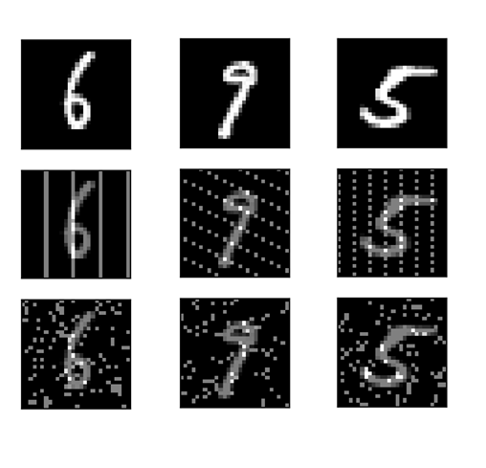
Quantifying the effect of patterns in irrelevant information
Run1
Run2
Run200
Structured
‘noise’
…
Reconstructed images
MNIST
Digit
Classification
Model
Denoising
accuracy
Random
noise

Slide 13
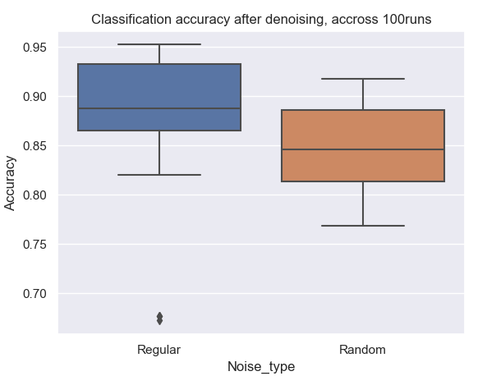
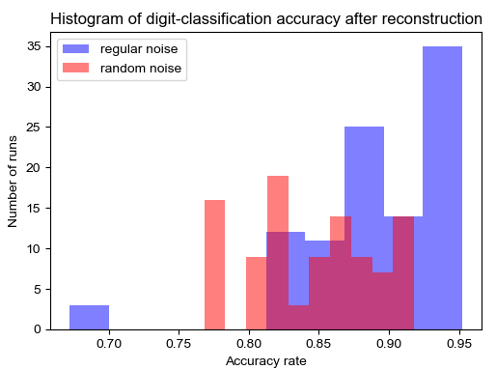
Results (p<0.001)

Slide 14
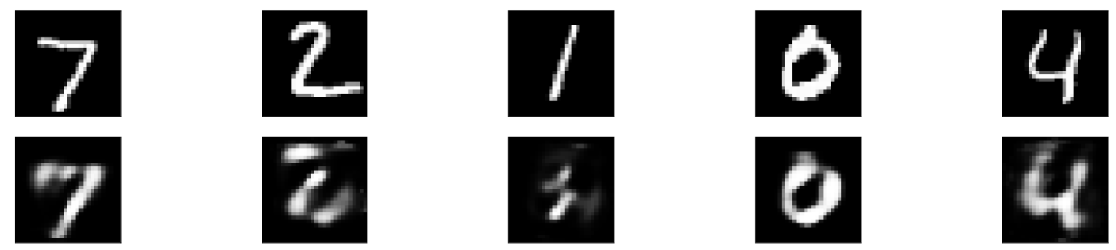
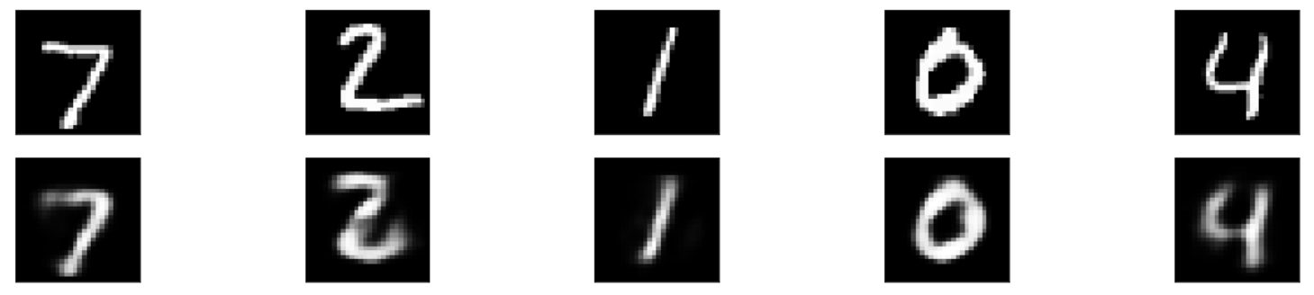
To be continued…
Train on regular, test on random
Train on random, test on regular

